Slide 1
Project 1
Group 4: Ryan Apolonio, Yuan Zhong,
Ramon Faylona, Linea Fuller

Slide 2
The Climate Data API
-Access to programmatic climate data that’s used on World Bank’s Climate Change Knowledge Portal
-Estimates of periodic temperature and precipitation changes measured by GCM’s
Global Circulation Models:
-Complex mathematical representation of major climate system components and their interactions to predict climate
-Accurate with small uncertainty
-Average Yearly temperature and precipitation change from 1901-2012
-Countries: USA, AUS, BRA
-A scientific consensus on the rise in global temperatures due to human activities; greenhouse gas emissions, deforestation, and intensive agriculture
-Definitively answer if the Earth’s temperature is rising and its effect on precipitation patterns
-We compared Time versus Temperature, Time versus Precipitation, and Temperature versus Precipitation

Slide 3
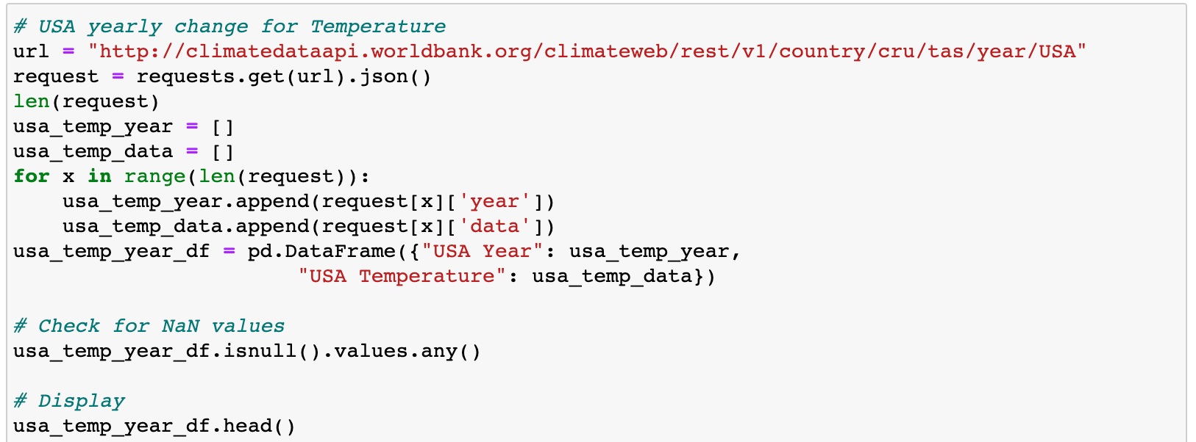
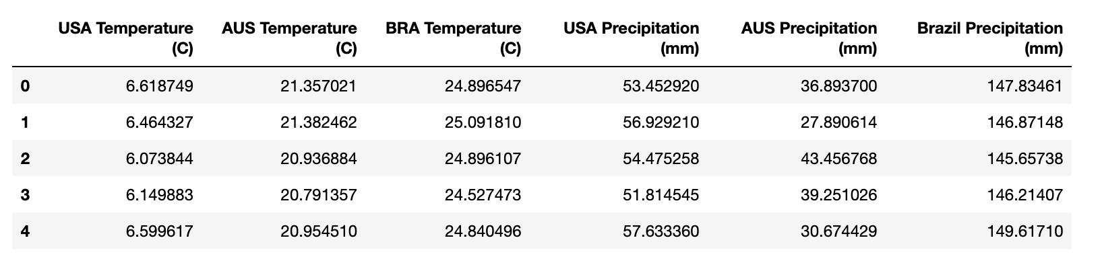
Cleaning Data and Creating Dataframes
-Checked for duplicates and NaN values within the database
-Assembled url and made an API request
-Pulled for specific data using a loop function and appended the extracted info into a list
-Converted and exported the dataframe as a csv file

Slide 4
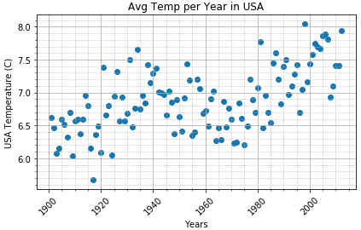
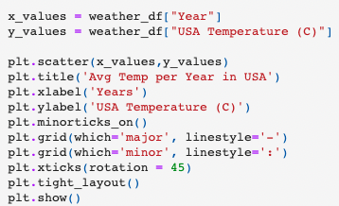
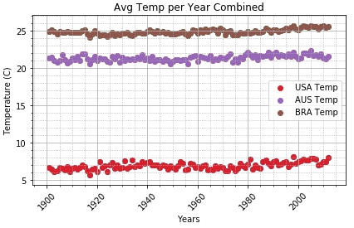
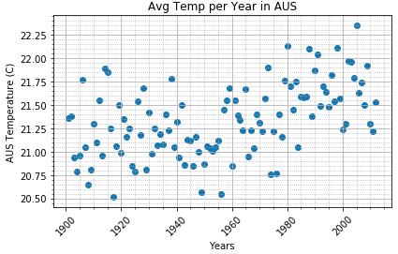
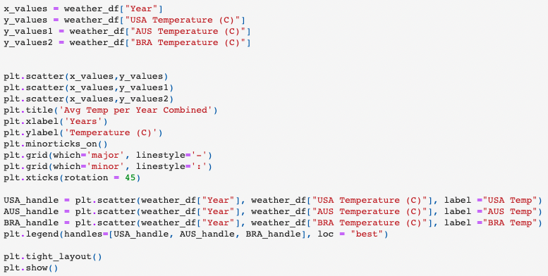
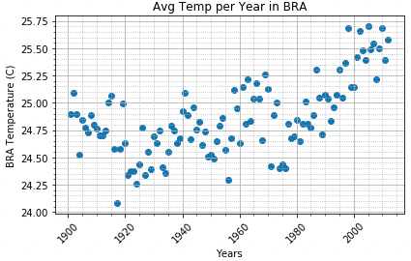
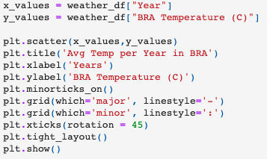
Time vs Temp
Sampling 3 countries located on the Northern Hemisphere, Southern Hemisphere and the Equator, indicates there is a rise of temperature Globally
Shown together as an overview shows minute movement in temperature, but broken down individually we see there is measurable movement

Slide 5
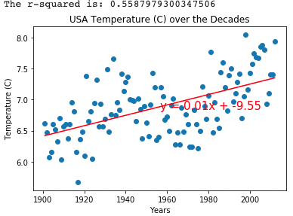

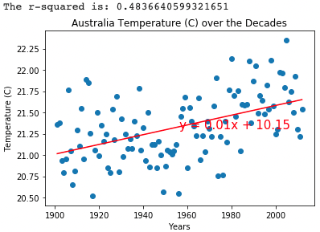

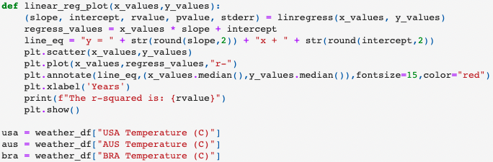
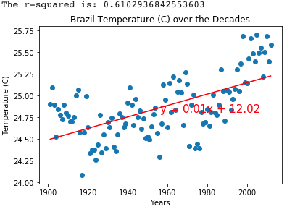

Time vs Temp contd..
Applying linear regression on the charts we see moderate rate of change based on Spearman’s rank correlation:
Conventionally:
|r|>0.8 => very strong relationship
0.6 ≤|r| strong relationship
0.4≤|r| moderate relationship
0.2 ≤|r| weak relationship
|r| very weak relationship

Slide 6
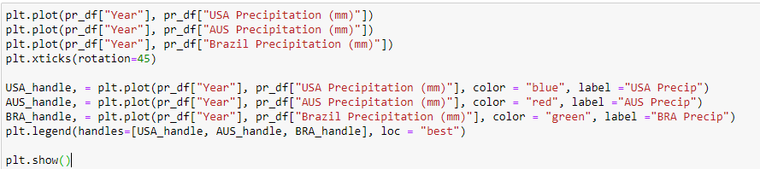
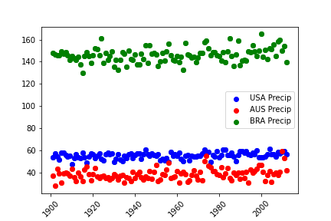
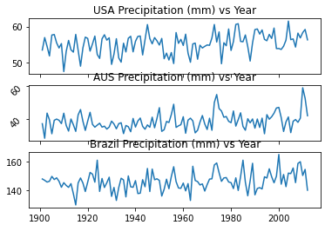
Time vs Precipitation
Comparison of three countries (USA, BRA, AUS)
Seems like slight increase
Brazil has higher precipitation

Slide 7
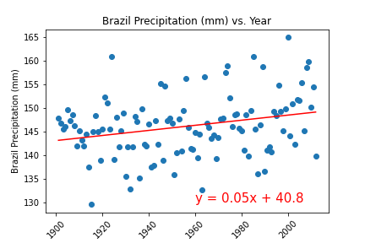
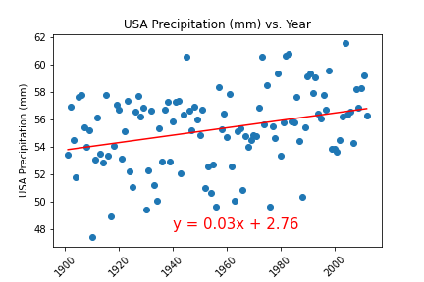

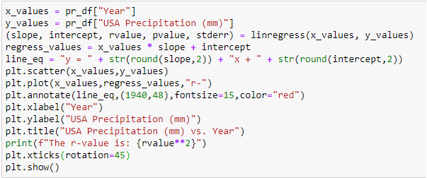
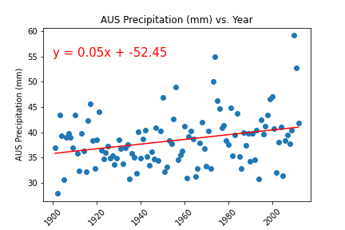
Time vs Precipitation
Linear regression
Slight increase
No correlation, low r-value

Slide 8
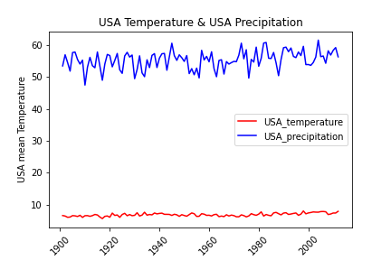
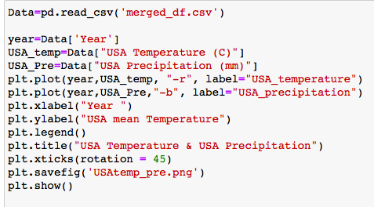
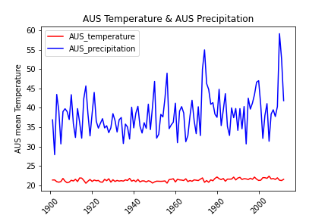
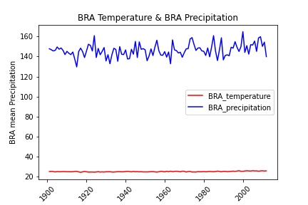
Temperature vs Precipitation
Temperature vs Precipitation

Slide 9
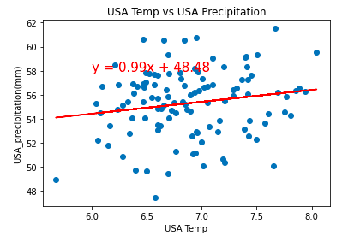
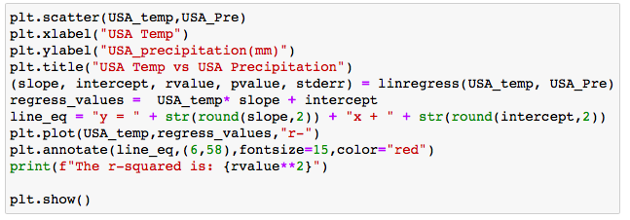
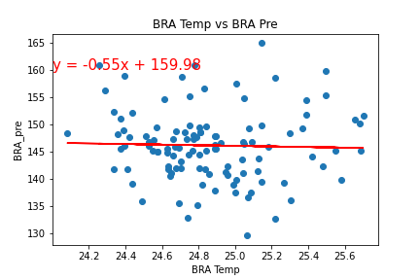
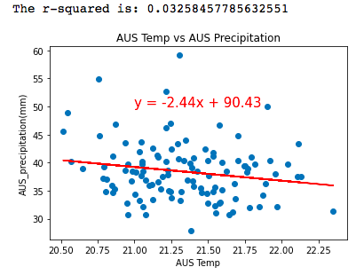
The correlation and linear regression analysis for Temperature and Precipitation for three countries
The r-squared is: 0.029497464029031233
The r-squared is: 0.0008969851544833486
The r-squared is: 0.03258457785632551
1.Temp & Pre is Biome specific
2.The rate of change is more informative

Slide 10
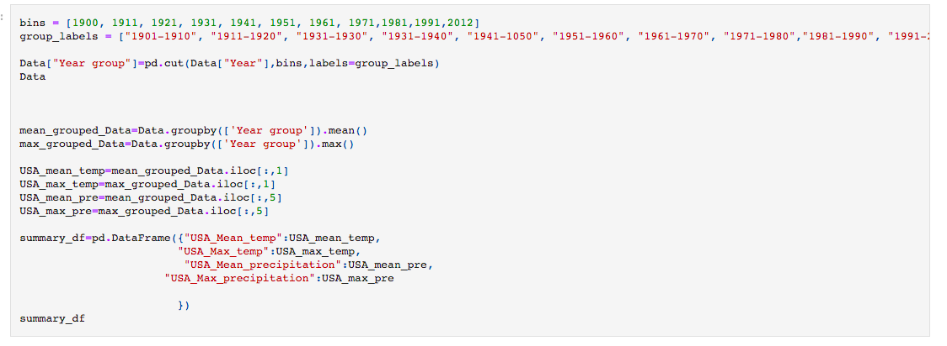
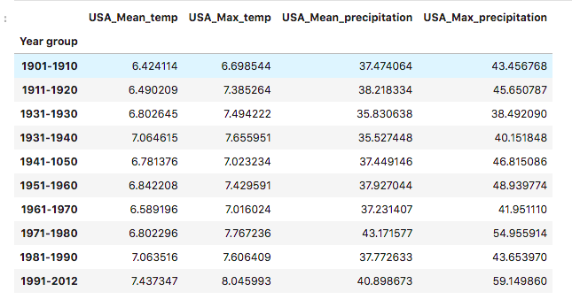
USA Temperature and precipitation analysis for every decade from 1901 to 2012

Slide 11
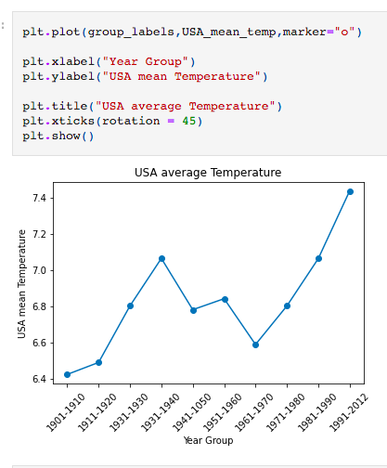
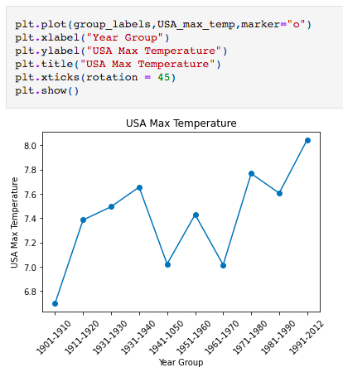
USA Average Temperature is rapidly increasing since 1961

Slide 12
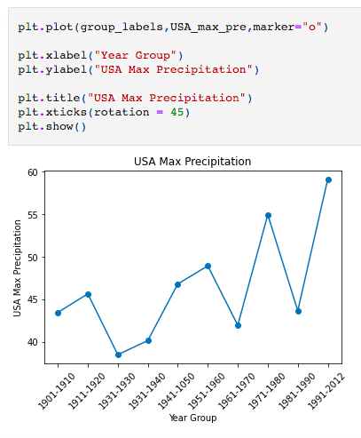
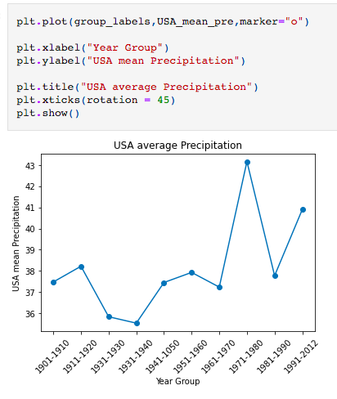
USA Average and Max Precipitation

Slide 13
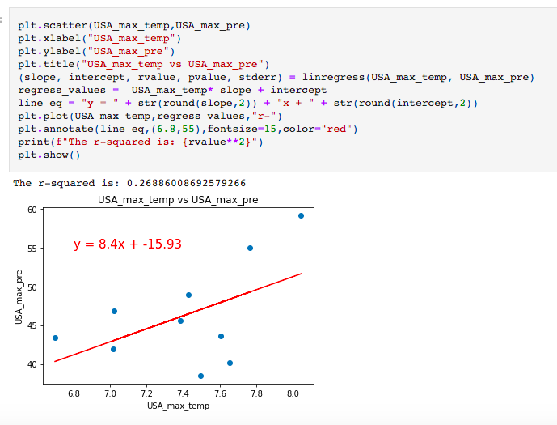
Max Temperature and Max Precipitation in USA has a week correlation

Slide 14
Conclusion
1. Time vs Temperature: All three countries showed in increase in temperature over the years. All three graphs produced significant r-values representing a moderatae correlation.
2. Time vs precipitation: Precipitation patters did not seem to change over time. The comparison for each country produced a weak r-value signifying that there was no significant relationship between time and precipitation.
3. Temperature vs precipitation: There is no correlation between average temperature and average precipitation. Interestingly, the average Tm change rate is climbing rapidly since 1961. There is a week correlation between Max Temp and Max Precipitation in USA from 1901 to 2012.

